Slide 1
Image Formation

Slide 2

Projection

Slide 3
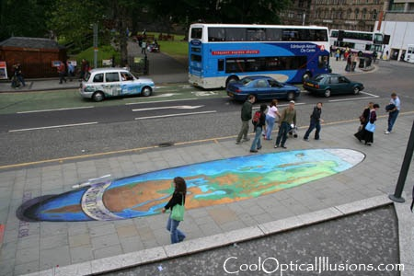
Projection

Slide 4

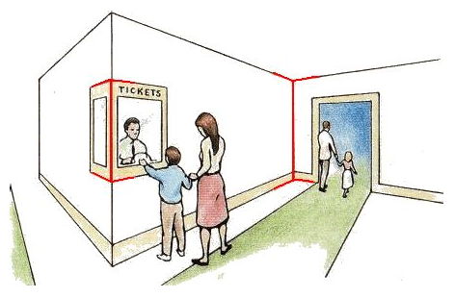
Müller-Lyer Illusion

Slide 5
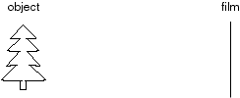
Image Formation
Let’s design a camera
Idea 1: put a piece of film in front of an object
Do we get a reasonable image?

Slide 6
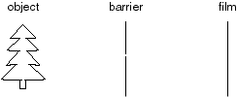
Pinhole Camera
Add a barrier to block off most of the rays
This reduces blurring
The opening known as the aperture
How does this transform the image?
Notes:
It gets inverted

Slide 7
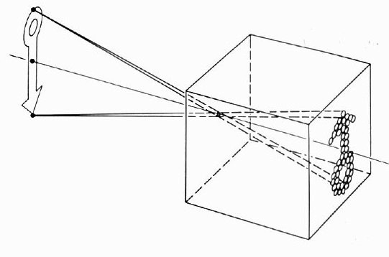
Camera Obscura
The first camera
Known to Aristotle
How does the aperture size affect the image?

Slide 8
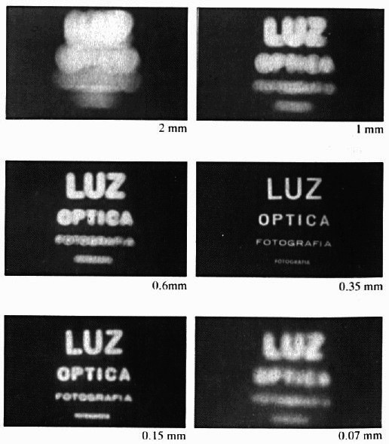
Shrinking the Aperture
Why not make the aperture as small as possible?
Less light gets through
Diffraction effects...

Slide 9
Shrinking the Aperture

Slide 10
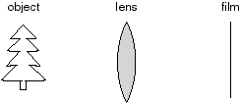
Adding a Lens
A lens focuses light onto the film
There is a specific distance at which objects are “in focus”
other points project to a “circle of confusion” in the image
Changing the shape of the lens changes this distance
“circle of
confusion”

Slide 11
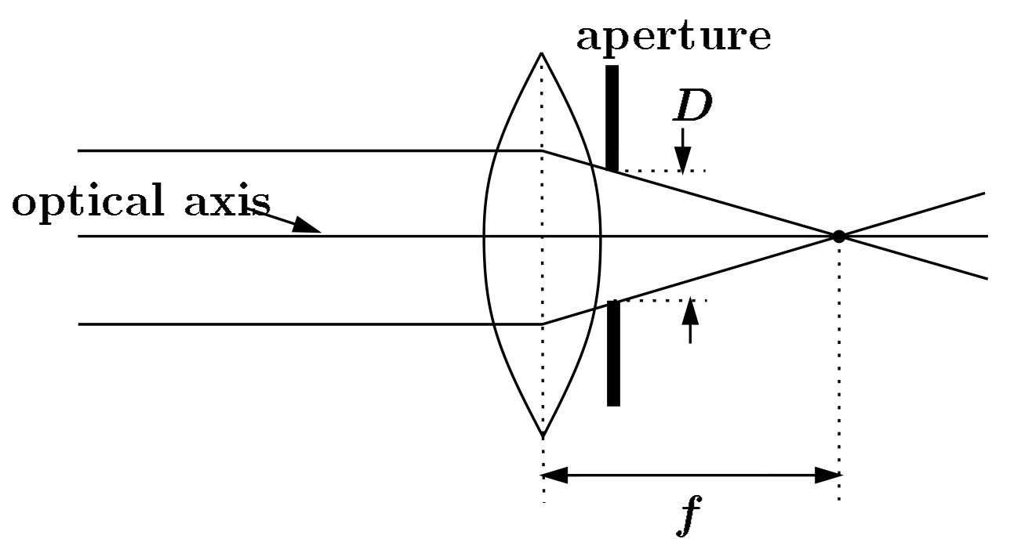
Lenses
A lens focuses parallel rays onto a single focal point
focal point at a distance f beyond the plane of the lens
f is a function of the shape and index of refraction of the lens
Aperture of diameter D restricts the range of rays
aperture may be on either side of the lens
Lenses are typically spherical (easier to produce)
F
optical center
(Center Of Projection)
focal point

Slide 12
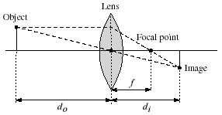
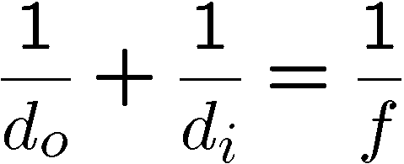
Thin Lenses
Thin lens equation:
Any object point satisfying this equation is in focus
What is the shape of the focus region?
How can we change the focus region?

Slide 13

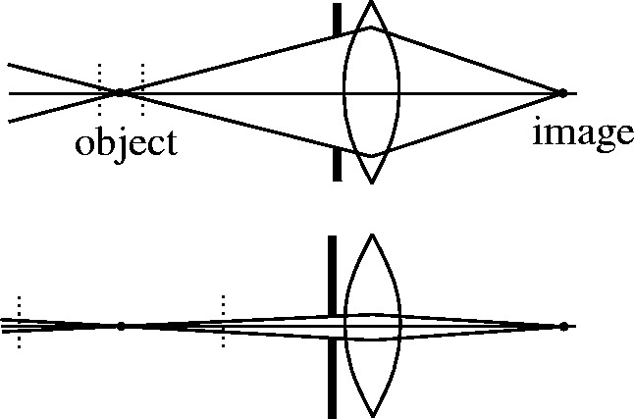

Depth of Field
Changing the aperture size affects depth of field
A smaller aperture increases the range in which the object is approximately in focus
f / 5.6
f / 32
Flower images from Wikipedia http://en.wikipedia.org/wiki/Depth_of_field

Slide 14
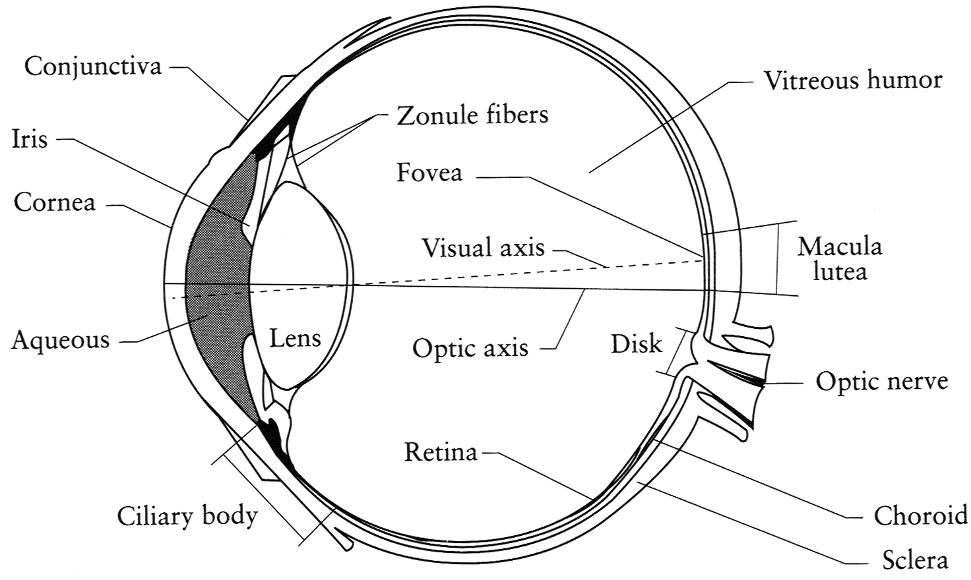
The Eye
The human eye is a camera
Iris - colored annulus with radial muscles
Pupil - the hole (aperture) whose size is controlled by the iris
What’s the “film”?
photoreceptor cells (rods and cones) in the retina
Notes:
Note that the retina is curved

Slide 15

Digital Camera
A digital camera replaces film with a sensor array
Each cell in the array is a Charge Coupled Device
light-sensitive diode that converts photons to electrons
other variants exist: CMOS is becoming more popular
http://electronics.howstuffworks.com/digital-camera.htm

Slide 16
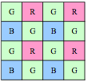
Issues with Digital Cameras
Noise
big difference between consumer vs. SLR-style cameras
low light is where you most notice noise
Compression
creates artifacts except in uncompressed formats (tiff, raw)
Color
color fringing artifacts from Bayer patterns
Blooming
charge overflowing into neighboring pixels

Slide 17
Issues with Digital Cameras
In-camera processing
oversharpening can produce halos
Interlaced vs. progressive scan video
even/odd rows from different exposures
Are more megapixels better?
requires higher quality lens
noise issues
Stabilization
compensate for camera shake (mechanical vs. electronic)

Slide 18
Other Important Camera Terminology
Shutter speed
exposure time
ISO
sensitivity control of sensor (gain)
Vignetting
Image getting darker to the boundary
Rolling Shutter
Chromatic aberration

Slide 19
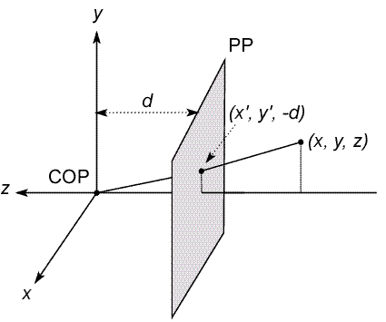
Modeling Projection
The coordinate system
We will use the pin-hole model as an approximation
Put the optical center (Center Of Projection) at the origin
Put the image plane (Projection Plane) in front of the COP
Why?
The camera looks down the negative z axis
we need this if we want right-handed-coordinates
Notes:
This way the image is right-side-up

Slide 20
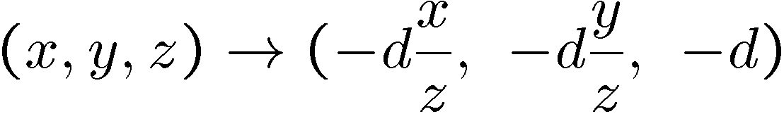
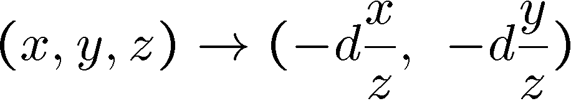
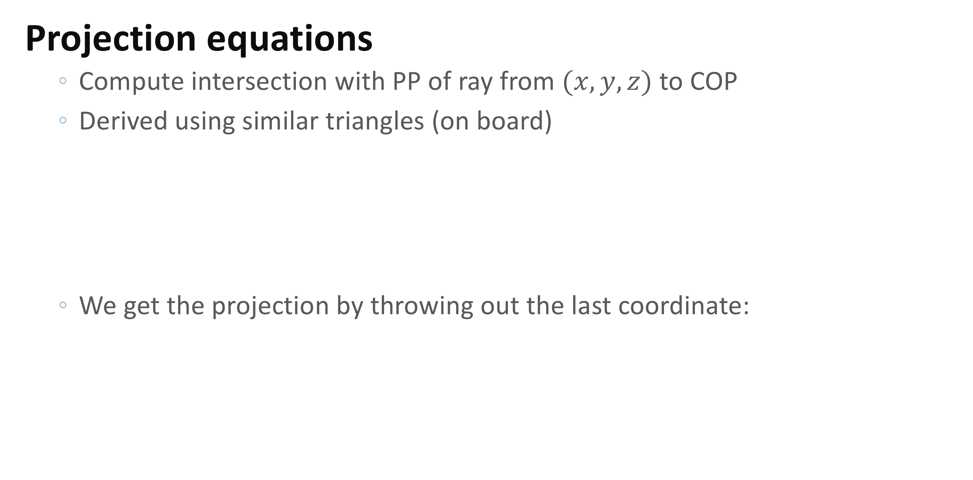
Modeling Projection
Projection equations
Compute intersection with PP of ray from $(x,y,z)$ to COP
Derived using similar triangles (on board)
We get the projection by throwing out the last coordinate:

Slide 21

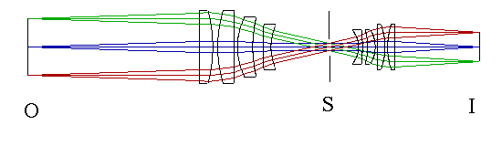
Orthographic (“telecentric”) Lenses
Navitar telecentric zoom lens
http://www.lhup.edu/~dsimanek/3d/telecent.htm

Slide 22
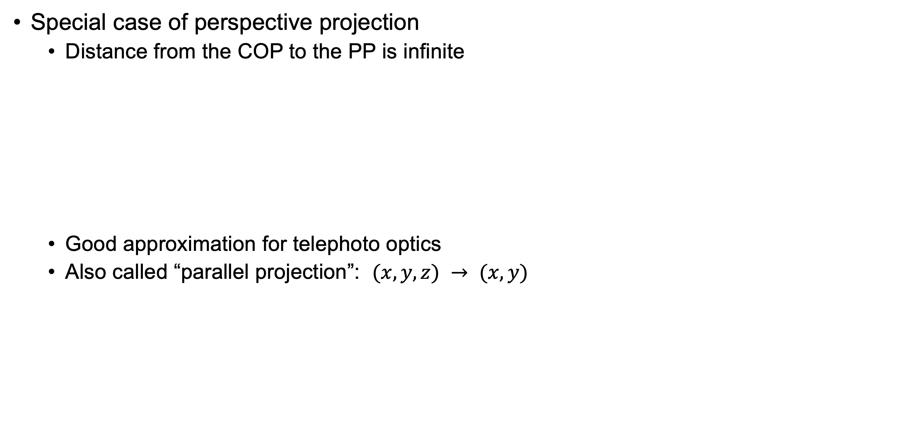
Orthographic Projection
Special case of perspective projection
Distance from the COP to the PP is infinite
Good approximation for telephoto optics
Also called “parallel projection”: $(x, y, z) → (x, y)$
Image
World

Slide 23
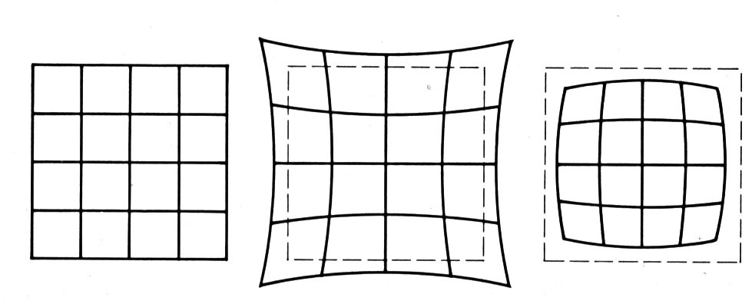
Distortion
Radial distortion of the image
Caused by imperfect lenses
Deviations are most noticeable for rays that pass through the edge of the lens
No distortion
Pin cushion
Barrel

Slide 24
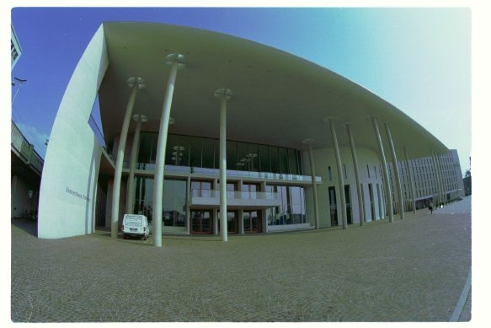
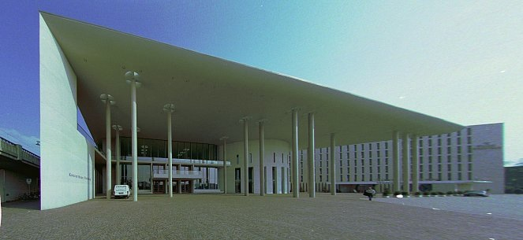
Correcting radial distortion
from Helmut Dersch

Slide 25
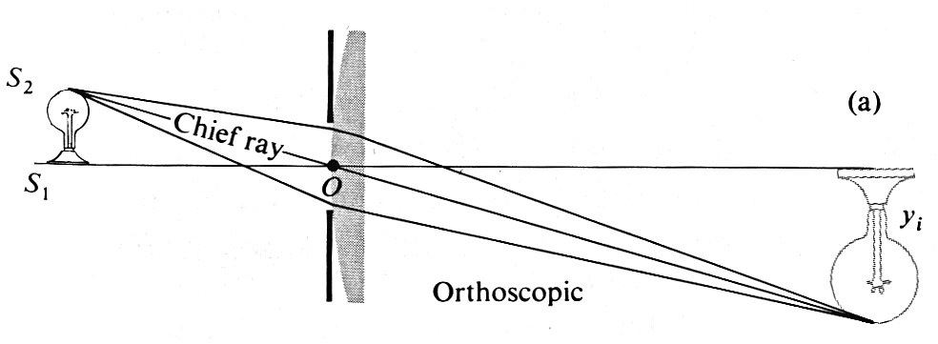
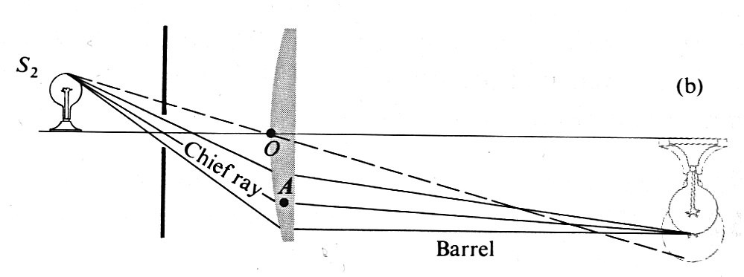
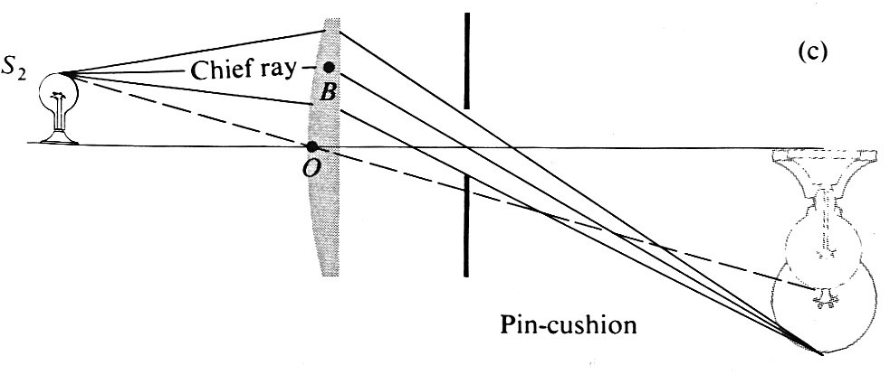
Distortion

Slide 26
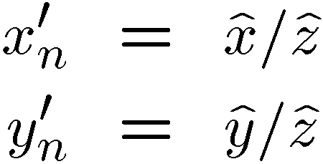
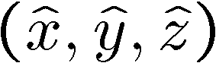
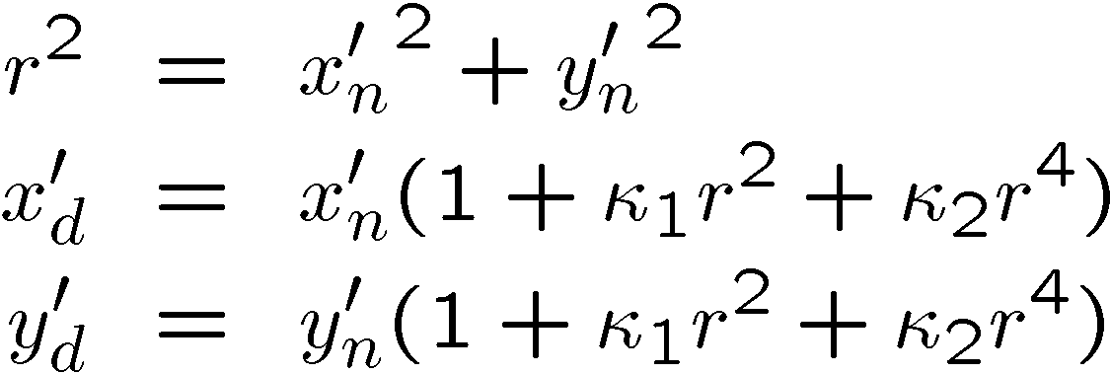
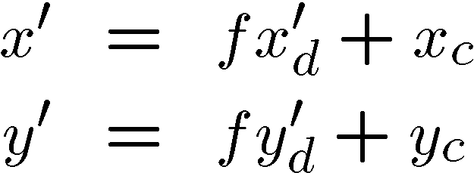
Modeling Distortion
To model lens distortion
Use above projection operation instead of standard projection matrix multiplication
Project to “normalized” image coordinates
Apply radial distortion
Apply focal length translate image center

Slide 27

360 Degree Field of View…
Basic approach
Take a photo of a parabolic mirror with an orthographic lens (Nayar)
Or buy one a lens from a variety of omnicam manufacturers…
See http://www.cis.upenn.edu/~kostas/omni.html

Slide 28
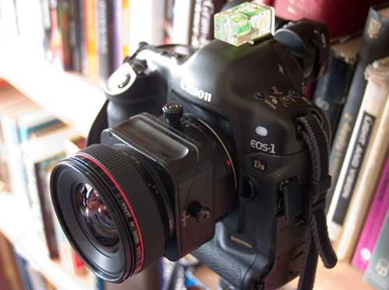
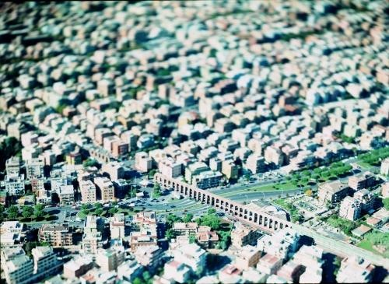
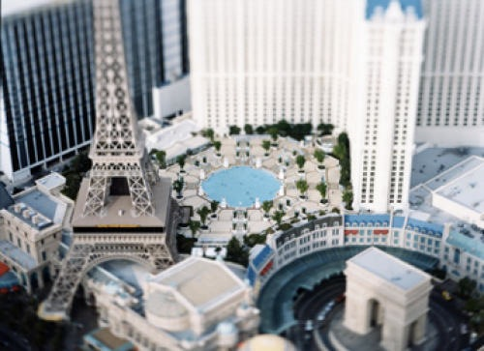
Tilt-shift
http://www.northlight-images.co.uk/article_pages/tilt_and_shift_ts-e.html
Tilt-shift images from Olivo Barbieri and Photoshop imitations

Slide 29


Rotating Sensor (or object)
Rollout Photographs © Justin Kerr
http://research.famsi.org/kerrmaya.html
Also known as “cyclographs”, “peripheral images”

Slide 30
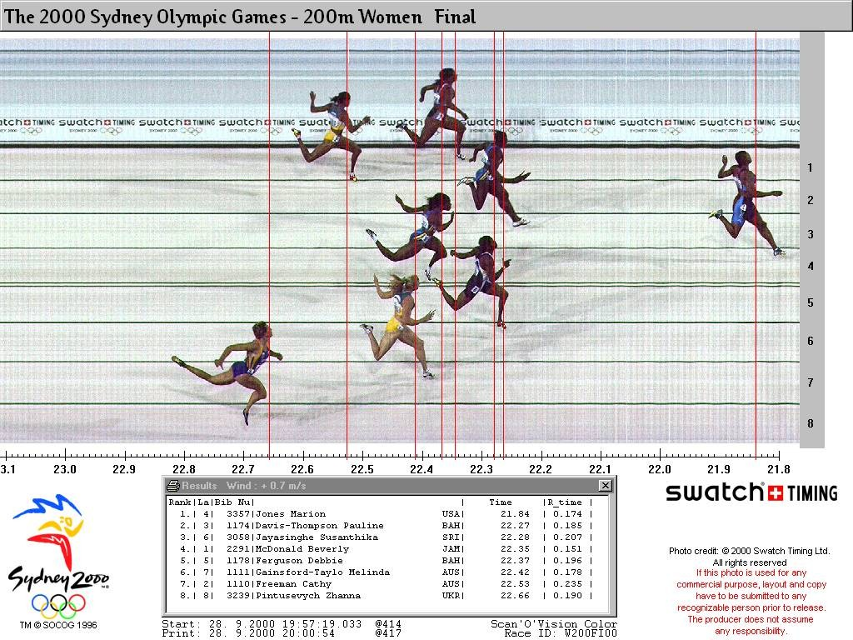
Photofinish

Slide 31
Projective Geometry

Slide 32
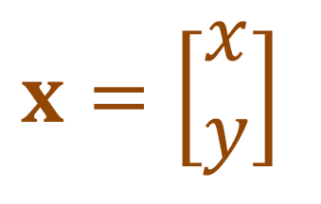
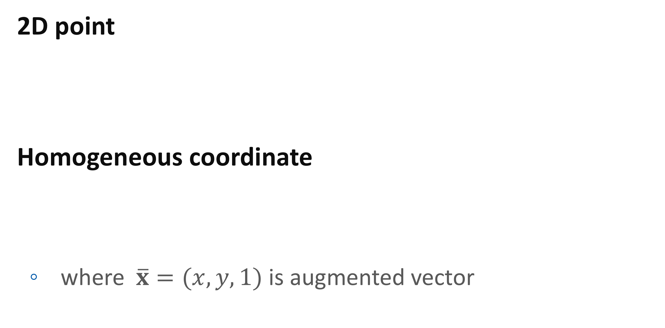
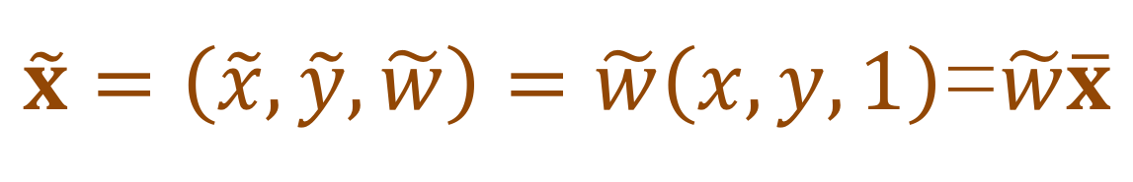
Geometric Primitives
$$x=\left[\begin{matrix}x \\ y\end{matrix}\right]$$
2D point
Homogeneous coordinate
where $\overline{x}=(x,y,1)$ is augmented vector
$\tilde{x}=\left(\tilde{x},\tilde{y},\tilde{w}\right)=\tilde{w}\left(x,y,1\right)$=$\tilde{w}\overline{x}$

Slide 33
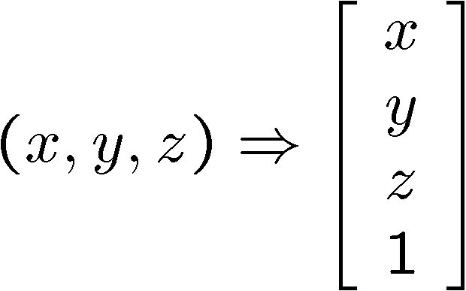
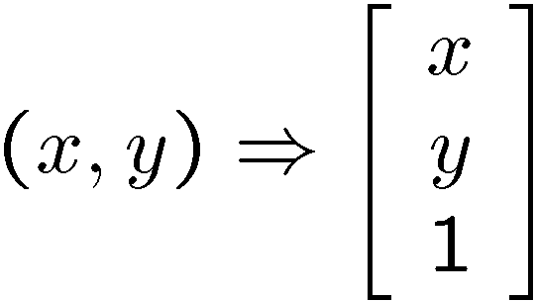
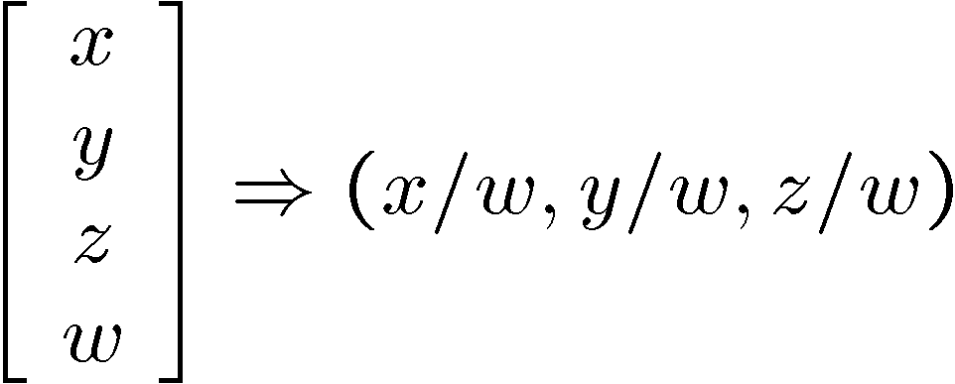
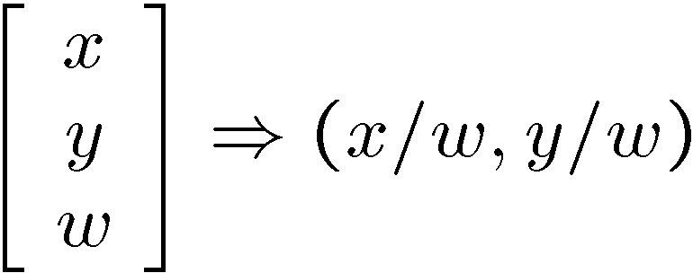
Homogeneous Coordinates
homogeneous image
coordinates
homogeneous scene
coordinates
Converting from homogeneous coordinates

Slide 34
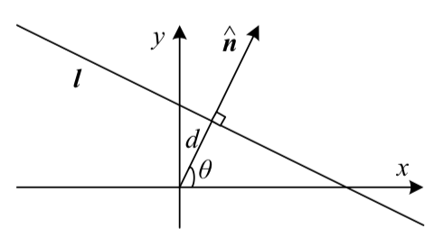
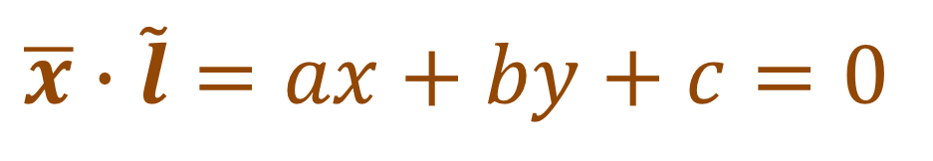
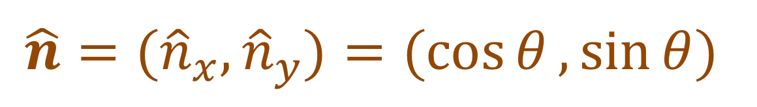
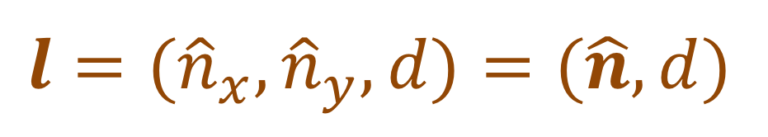
2D Lines
Using homogenous coordinate
Normal & distance
Direction
Line intersection
Line joining two points
$$\overline{x}∙\tilde{l}=ax+by+c=0$$
$$l=({\hat{n}}_{x},{\hat{n}}_{y},d)=(\hat{n},d)$$
$$\hat{n}=({\hat{n}}_{x},{\hat{n}}_{y})=(\cos{θ},\sin{θ})$$

Slide 35
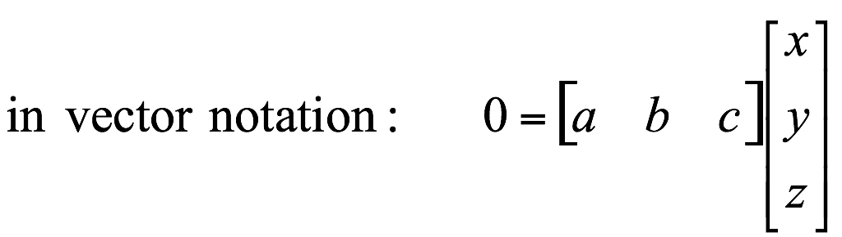

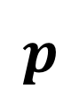
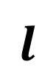
Projective Lines
What does a line in the image correspond to in projective space?
A line is a plane of rays through origin
all rays $(x,y,z)$ satisfying: $ax + by + cz = 0$
$$l$$
$$p$$
A line is also represented as a homogeneous 3-vector $l$

Slide 36
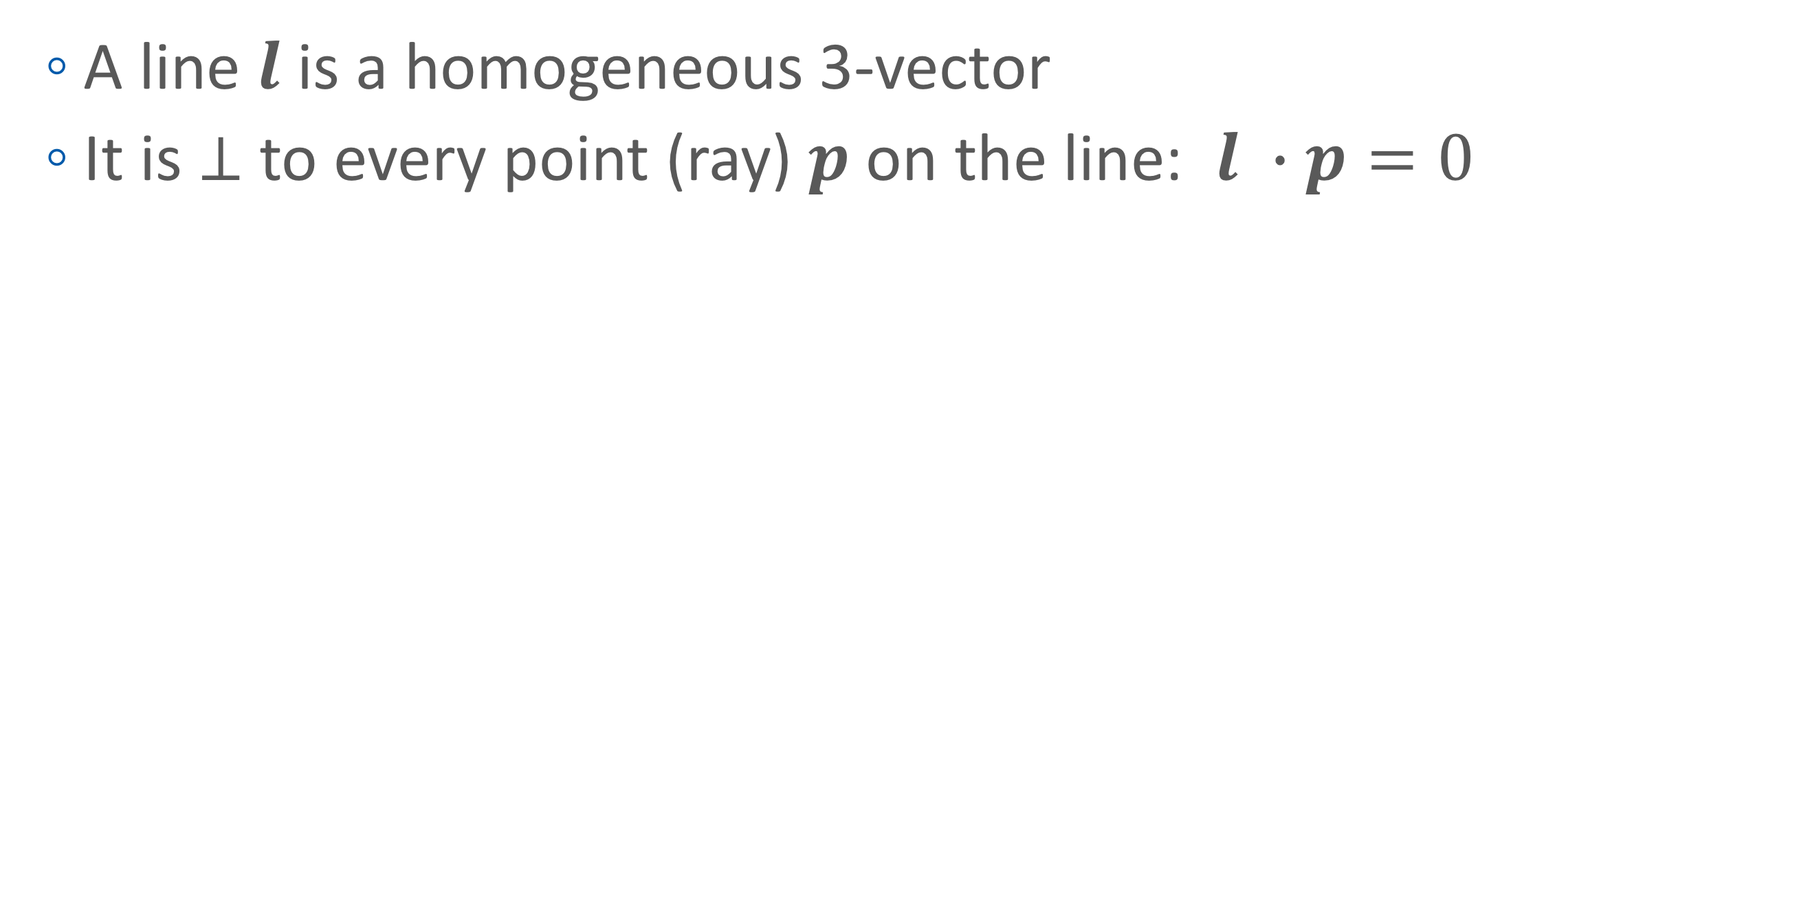
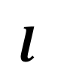

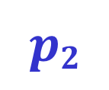

Point and Line Duality
A line $l$ is a homogeneous 3-vector
It is ⊥ to every point (ray) $p$ on the line: $l ∙p=0$
$$p1$$
$$p2$$
$$l$$
What is the line $l$ spanned by rays $p1$ and $p2$ ?
$l$ is ⊥ to $p1$ and $p2$ ⇒ $l = p1×p2$
$l$ is the plane normal

Slide 37




Point and Line Duality
What is the intersection of two lines $l_{1}$ and $l_{2}$ ?
$p$ is ⊥ to $l_{1}$ and $l_{2}$ ⇒ $p=l_{1} ×l_{2}$
Points and lines are dual in projective space
given any formula, can switch the meanings of points and lines to get another formula
$$l1$$
$$p$$
$$l2$$

Slide 38


3D
3D points
3D planes
Direction?
3D lines

Slide 39







The Projective Plane
Why do we need homogeneous coordinates?
represent points at infinity, homographies, perspective projection, multi-view relationships
What is the geometric intuition?
a point in the image is a ray in projective space
Each point $(x,y)$ on the plane is represented by a ray $(sx,sy,s)$
all points on the ray are equivalent: $(x, y, 1) ≅ (sx, sy, s)$
$$−y$$
$$(sx,sy,s)$$
$$(x,y,1)$$
$$(0,0,0)$$
$$−z$$
$$x$$
image plane

Slide 40
2D Transformation
Translation
Rotation + translation
Scaled
Rotation:

Slide 41
General Affine
Note that x’ is not homogeneous coordinate

Slide 42
Projective
Perspective transform or homography operator
H is arbitrary 3x3 matrix
H is homogeneous
Transformation

Slide 43
3D transformations
Translation:
Rotation+translation:
Scaled:
Affine:
Projective

Slide 44
3D to 2D: “perspective” projection
Matrix Projection:
What is not preserved under perspective projection?
What IS preserved?
Notes:
Preserved: lines, incidence
Not preserved: lengths, angles, parallelism

Slide 45
Modeling projection
Projection equations
Compute intersection with PP of ray from $(x,y,z)$ to COP
Derived using similar triangles (on board)
We get the projection by throwing out the last coordinate:

Slide 46

Cross-ratio
(A,B;C,D)
(A,B;C,D) = (A’,B’;C’,D’)
(A-C)(B-D)/(B-C)(A-D)=k
In homogeneous coordinates
c=a+b, d=ka+b => cross-ratio=k

Slide 47



Perspective Projection
Projection is a matrix multiply using homogeneous coordinates:
This is known as perspective projection
The matrix is the projection matrix
divide by third coordinate

Slide 48


Perspective Projection
How does scaling the projection matrix change the transformation?

Slide 49


Perspective Projection
For projection plane at z = -1

Slide 50



Orthographic Projection
Special case of perspective projection
Distance from the COP to the PP is infinite

Slide 51

Camera Parameters
Projection equation
The projection matrix models the cumulative effect of all parameters
Useful to decompose into a series of operations

Slide 52






Camera Parameters
A camera is described by several parameters
Translation $T$ of the optical center from the origin of world coords
Rotation $R$ of the image plane
focal length f, principle point $(x’c, y’c)$, pixel size $\left(sx, sy\right)$
blue parameters are called “extrinsics,” red are “intrinsics”

Slide 53



Camera Intrinsics
Projection plane to image plane
$f_{x}$ and $f_{y}$ are called focal length $f_{x}$ and $f_{y}$
$c_{x}$ and $c_{y}$ is the position of COP at the image
$$K=\left[\begin{matrix}f_{x} & 0 & c_{x} \\ 0 & f_{y} & c_{y} \\ 0 & 0 & 1\end{matrix}\right]$$

Slide 54



Focal Length
Focal length wrt View angle
$$\tan{\frac{θ}{2}=\frac{W}{2}}$$
$$f{=\frac{W}{2}}{\left[\tan{\frac{θ}{2}}\right]}^{−1}$$

Slide 55

Camera parameters
Projection equation
$P=\left[\begin{matrix}f_{x} & s & c_{x} \\ 0 & f_{y} & c_{y} \\ 0 & 0 & 1\end{matrix}\right]\left[\begin{matrix}1 & 0 & 0 & 0 \\ 0 & 1 & 0 & 0 \\ 0 & 0 & 1 & 0\end{matrix}\right]\left[\begin{matrix}R_{3×3} & 0 \\ 0 & 1\end{matrix}\right]\left[\begin{matrix}I_{3×3} & t \\ 0 & 1\end{matrix}\right]$
The definitions of these parameters are not completely standardized
especially intrinsics—varies from one book to another
${\overline{x}}_{s}=Pp=K\left[R | t\right]p_{w}$
intrinsics
projection
rotation
translation

Slide 56

Camera Matrix
4x4 version of Camera matrix
$\tilde{P}=\left[\begin{matrix}K & 0 \\ 0 & 1\end{matrix}\right]\left[\begin{matrix}R & t \\ 0 & 1\end{matrix}\right]=\tilde{K}E$

Slide 57

Mapping from One Camera to Another

Slide 58
Mapping from One Camera to Another
World to Screen coordinate
World coordinate
which cannot be determined

Slide 59

Mapping from One Camera to Another
onto another image
Note that $\tilde{K}E$ is 4x4 matrix
${\tilde{x}}_{0}$ and ${\tilde{x}}_{1}$ is 3D points with unknown $d$

Slide 60


Mapping from One Camera to Another
Letting p is on a plane
${\hat{n}}_{0}∙p+c_{0}=0$
The result is 3x3 (2D) homographs matrix
8 degree of freedom

Slide 61


Homographies of Points and Lines
Computed by 3x3 matrix multiplication
To transform a point: $p’ = Hp$
To transform a line: $l∙p=0 → l’∙p’=0$
$0 = l∙p = lH^{−1}Hp = lH^{−1}p’ ⟹l’ = lH^{−1}$
lines are transformed by postmultiplication of $H^{−1}$

Slide 62

Ideal Points and Lines
Ideal point (“point at infinity”)
$p≅(x, y, 0)$ – parallel to image plane
It has infinite image coordinates
Ideal line
$l≅(a, b, 0)$ – parallel to image plane
Corresponds to a line in the image (finite coordinates)
goes through image origin (principle point)
(a,b,0)
-y
(sx,sy,0)
-y
-z
x
image plane
-z
image plane
x

Slide 63

3D Projective Geometry
These concepts generalize naturally to 3D
Homogeneous coordinates
Projective 3D points have four coords: $P = (X,Y,Z,W)$
Duality
A plane N is also represented by a 4-vector
Points and planes are dual in 3D: $N P=0$
Projective transformations
Represented by 4x4 matrices $T$: $P’ = TP, N’ = N T^{−1}$

Slide 64
Vanishing points
Vanishing point
projection of a point at infinity
image plane
vanishing point v
camera
center
C
line on ground plane

Slide 65
Vanishing points
Properties
Any two parallel lines have the same vanishing point v
The ray from C through v is parallel to the lines
An image may have more than one vanishing point
in fact every pixel is a potential vanishing point
image plane
vanishing point v
camera
center
C
line on ground plane
line on ground plane
Notes:
How to determine which lines in the scene vanish at a given pixel?

Slide 66
Vanishing lines
Multiple Vanishing Points
Any set of parallel lines on the plane define a vanishing point
The union of all of vanishing points from lines on the same plane is the vanishing line
For the ground plane, this is called the horizon
v₁
v₂

Slide 67
Vanishing lines
Multiple Vanishing Points
Different planes define different vanishing lines

Slide 68


Computing vanishing points
V
P₀
D

Slide 69



Computing vanishing points
Properties
P∞ is a point at infinity, v is its projection
They depend only on line direction
Parallel lines $P_{0}+tD$, $P_{1}+ tD$ intersect at $P_{∞}$

Slide 70



Computing the horizon
Properties
$l$ is intersection of horizontal plane through $C$ with image plane
Compute $l$ from two sets of parallel lines on ground plane
All points at same height as $C$ project to $l$
points higher than $C$ project above $l$
Provides way of comparing height of objects in the scene
$$C$$
$$l$$
ground plane

Slide 71
Questions?

